Slide 1
SWE 4803
Lec – 6

Slide 2
Plan Risk Management
The process of defining how to conduct risk management activities for the projects
Process
Output
Plan risk management
Risk management plan

Slide 3
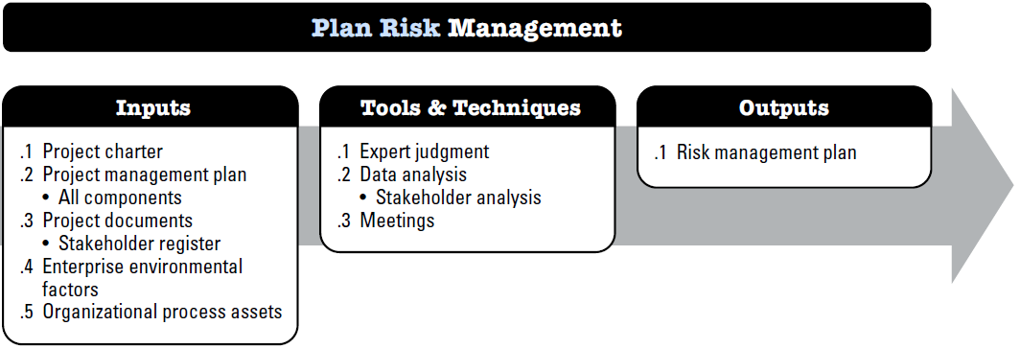
Plan Risk Management

Slide 4
Plan Risk Management
Input:
PROJECT MANAGEMENT PLAN
All components
PROJECT DOCUMENTS
Stakeholder register
Project Charter
Includes high-level project description and boundaries, high-level requirements, and risks.
EEF - overall risk thresholds set by the organizations or key stakeholders.
EEF & OPA
OPA - Organizational risk policy, Risk categories, possibly organized into a risk breakdown structure, Templates for the risk management plan, risk register, and risk report, Lessons learned repository from previous similar projects.

Slide 5
Plan Risk Management
Tools & Techniques:
Expert judgment
Data Analysis
Meetings

Slide 6
Plan Risk Management
Output: Risk Management Plan
describes how risk management activities will be structured and performed and includes
1. Risk strategy. Describes the general approach to managing risk on this project.
2. Methodology. Defines the specific approaches, tools, and data sources that will be used to perform risk management on the project.
3. Roles and responsibilities. Defines the lead, support, and risk management team members for each type of activity described in the risk management plan, and clarifies their responsibilities
4. Funding. Identifies the funds needed to perform activities related to Project Risk Management
5. Timing. Defines when and how often the Project Risk Management processes will be performed throughout the project life cycle and establishes risk management activities for inclusion into the project schedule.
6. Risk categories. Provide a means for grouping individual project risks. A common way to structure risk categories is with a risk breakdown structure (RBS)

Slide 7
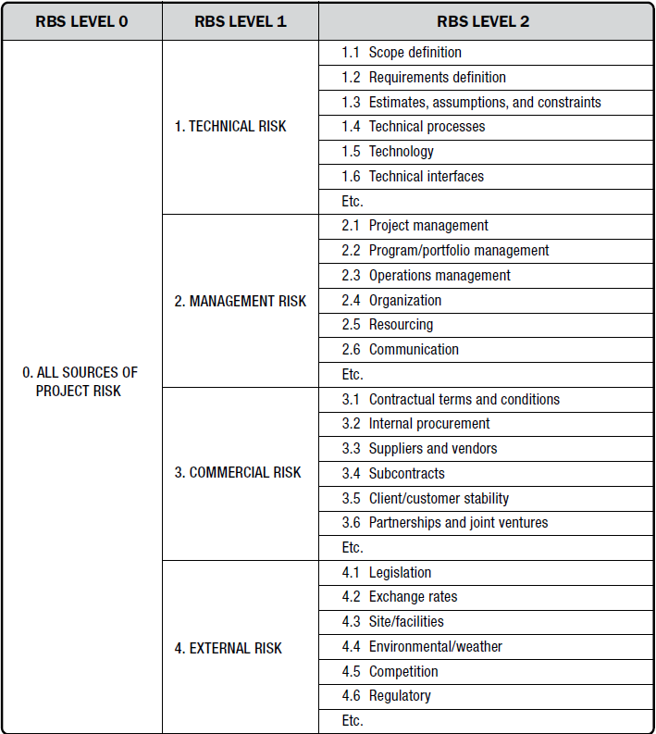

Slide 8
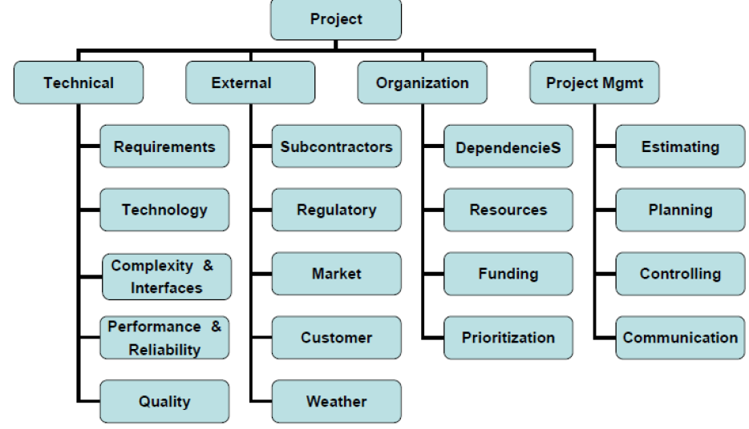

Slide 9
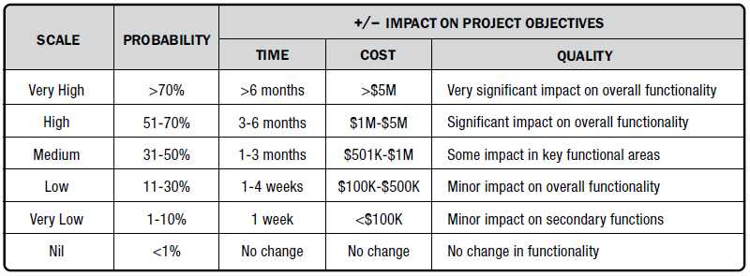
Plan Risk Management
Output: Risk Management Plan
7. Stakeholder risk appetite.
Stakeholders' risk appetite should be defined using measurable risk thresholds for each project objective.
These thresholds specify the maximum acceptable level of project risk exposure.
They provide a basis for evaluating and prioritizing project risks.
Risk thresholds help define the probability and impact scales used in risk assessment.
8. Definitions of risk probability and impacts.

Slide 10
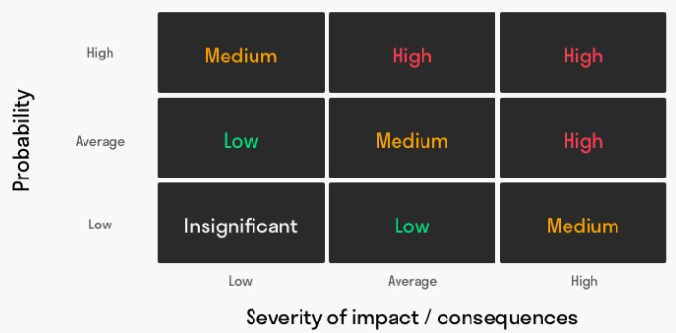
Plan Risk Management
Output: Risk Management Plan
9. probability and impact matrix.
Probability: This explains how likely it is for a risk (uncertain event) to occur. It ranges from 0% to 100%. It won’t be 100% though because that’s entirely certain and it wouldn’t be 0% because then there’s no risk involved.
Impact: Risks create negative outcomes. But their effects vary in terms of costs and impact.

Slide 11
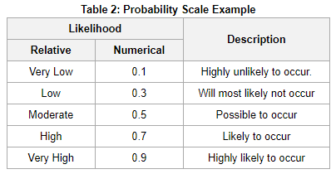
Plan Risk Management
Output: Risk Management Plan
9. probability and impact matrix.

Slide 12
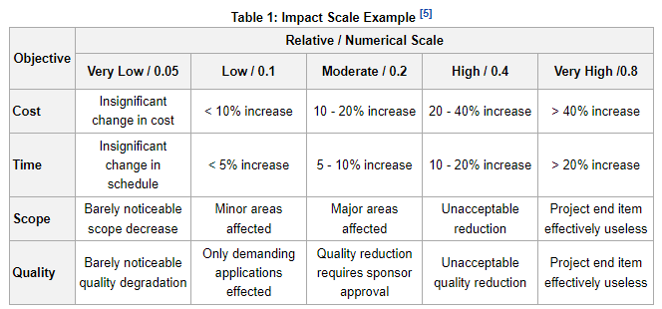
Plan Risk Management
Output: Risk Management Plan
9. probability and impact matrix.

Slide 13
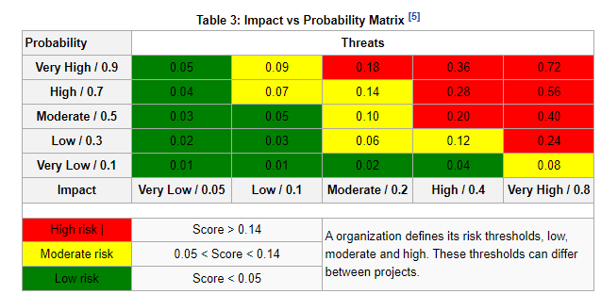
Plan Risk Management
Output: Risk Management Plan
9. probability and impact matrix.
Risk = Impact x Probability

Slide 14
Plan Risk Management
Output: Risk Management Plan
10. Reporting formats Reporting formats define how the outcomes of the Project Risk Management process will be documented, analyzed, and communicated.
11. Tracking. Tracking documents how risk activities will be recorded and how risk management processes will be audited.

Slide 15
Identify Risks
The process of determining which risk may affect the project and documenting their characteristics
Process
Output
Identify risk
Risk register
Risk Report
Project Doc update

Slide 16
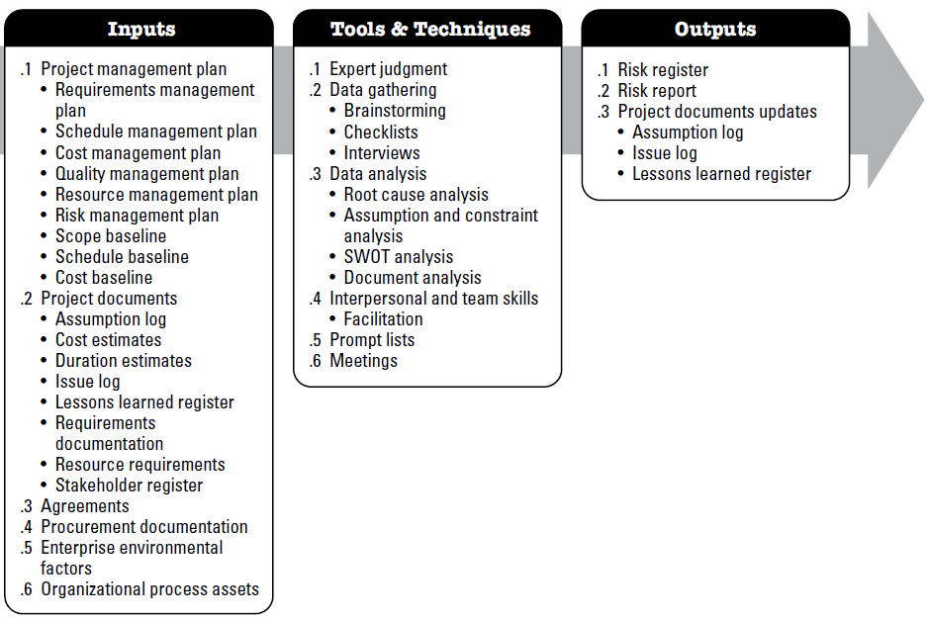
Identify Risks

Slide 17
Identify Risks
Input:
Project management plan
Requirements management plan, Schedule management plan, Cost management plan, Quality management plan, Resource management plan, Risk management plan, Scope baseline, Schedule baseline ,Cost baseline
Project documents
Assumption log ,Cost estimates, Duration estimates, Issue log, Lessons learned register, Requirements documentation, resource requirements, Stakeholder register
Agreements
external procurement of resources
external procurement of resources,
Procurement documentation
EEF - Published material, including commercial risk databases, Benchmarking results, and Industry studies of similar projects.
EEF &
OPA
OPA - Project files, including actual data, Organizational and project process controls, Risk statement formats, and •Checklists from previous similar projects.

Slide 18
Identify Risks
Tools & Techniques:
Expert judgment
Data Gathering - Brainstorming , Checklists, Interviews
Data Analysis – Root Cause Analysis, Assumption and constraint analysis, SWOT Analysis, Document Analysis
Interpersonal and team skills – Facilitation
Prompt list
Meetings
The risk categories in the lowest level of the risk breakdown structure can be used as a prompt list for individual project risks. Some common strategic frameworks are more suitable for identifying sources of overall project risk, for example
PESTLE (political, economic, social, technological, legal, environmental)
TECOP (technical, environmental, commercial, operational, political)

Slide 19
Identify Risks
Output:
RISK REGISTER
List of identified risks.
RISK REPORT
The risk report is developed progressively throughout the Project Risk Management process. On completion of the Identify Risks process, information in the risk report may include but is not limited to:
Assumption log.
PROJECT DOCUMENTS UPDATES
Issue log
Lessons learned register
Potential risk owners.
List of potential risk responses.
Sources of overall project risk, indicating which are the most important drivers of overall project risk exposure; and
Summary information on identified individual project risks, such as number of identified threats and opportunities, distribution of risks across risk categories, metrics and trends, etc.

Slide 20
RISK REGISTER
Risk Description | Potential Risk Owner | Potential Risk Response
Key developer may leave the project before completion. | Project Manager | Cross-train team members, maintain proper documentation, and prepare a backup resource.
Third-party API or cloud service may become unavailable. | Technical Lead | Identify alternative providers and implement fallback mechanisms.
Development server or source code repository may fail. | DevOps Engineer | Perform regular backups and use redundant cloud infrastructure with disaster recovery plans.

Slide 21
Perform qualitative risk analysis
The process of prioritizing risks for further analysis or action by assessing and combining their probability of occurrence and impact.
Process
Output
Perform qualitative risk analysis
Project Doc update

Slide 22
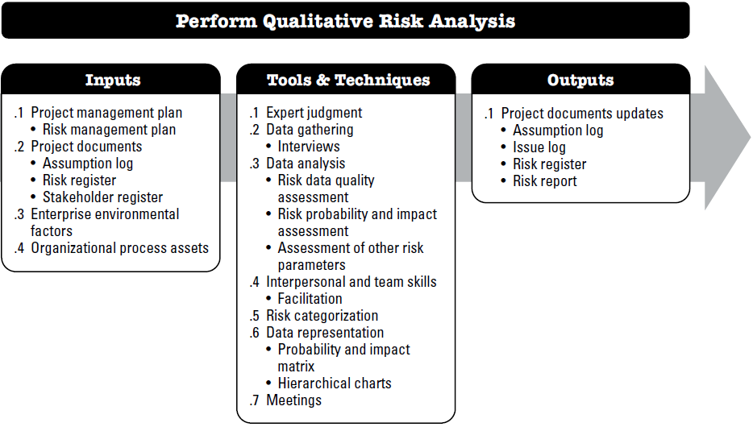
Perform qualitative risk analysis

Slide 23
Perform qualitative risk analysis
Input:
Project management plan
Risk management plan
Project documents
Assumption log
EEF - Industry studies of similar projects, and Published material, including commercial risk databases or checklists.
EEF & OPA
Risk register
Stakeholder register
OPA - The organizational process assets that can influence Perform Qualitative Risk Analysis include but are not limited to information from similar completed projects.

Slide 24
Perform qualitative risk analysis
Tools & Techniques:
Expert judgment
Data Gathering - Interviews
Data Analysis – Risk data quality assessment, Risk probability and impact assessment , Assessment of other risk parameters
Interpersonal and team skills – Facilitation
Risk Categorization
Data Representation – Probability and impact matrix, Hierarchical charts
Meetings
Risks to the project can be categorized by sources of risk (e.g., using the risk breakdown structure (RBS); the area of the project affected (e.g., using the work breakdown structure (WBS); , or other useful categories (e.g., project phase, project budget, and roles and responsibilities) to determine the areas of the project most exposed to the effects of uncertainty. Risks can also be categorized by common root causes. Risk categories that may be used for the project are defined in the risk management plan.

Slide 25
Perform qualitative risk analysis
Tools & Techniques:
Assessment of other risk parameters
Parameter | Meaning | Desired Value | Why
Urgency | How quickly a response is needed. | Low ✅ | More time is available to plan and respond.
Proximity | How soon the risk may occur. | Low ✅ | The risk is farther in the future.
Dormancy | Time before the impact becomes visible. | Low ✅ | The impact is detected quickly, allowing faster response.
Manageability | Ease of managing the risk. | High ✅ | Easier to manage and mitigate.
Controllability | Ability to influence the outcome. | High ✅ | Greater control over the risk.
Detectability | Ease of detecting the risk. | High ✅ | The risk can be identified early.
Connectivity | Degree of dependence on other risks. | Low ✅ | Less chance of triggering or being affected by other risks.
Strategic Impact | Effect on organizational goals. | Low ✅ | Less damage (or disruption) to strategic objectives.
Propinquity | Importance of the risk to stakeholders. | Low ✅ | Fewer stakeholder concerns and less pressure.
Risk assessment parameters help prioritize risks by considering not only their probability and impact, but also factors such as timing, visibility, controllability, stakeholder concern, and business importance.

Slide 26
Perform qualitative risk analysis
Tools & Techniques:
Assessment of other risk parameters : Example
The university admission website crashes during admission result publication due to extremely high user traffic.
Parameter | Assessment | Explanation
Urgency | 🔴 High | The server must be restored immediately because thousands of applicants are waiting.
Proximity | 🔴 High | The risk is expected when the result publication time approaches.
Dormancy | 🟢 Low | The impact is noticed instantly. Students cannot access the website.
Manageability | 🟡 Medium | IT staff can add servers, restart services, or switch to backup infrastructure, but recovery takes effort.
Controllability | 🟢 High | Load balancing, cloud auto-scaling, caching, and stress testing can greatly reduce the risk.
Detectability | 🟢 High | Monitoring tools quickly detect high CPU usage, slow response times, or server failures.
Connectivity | 🔴 High | The crash affects result viewing, login, payment systems, help desk operations, and university reputation.
Strategic Impact | 🔴 High | The university may lose public trust and face negative media coverage, affecting future admissions.
Propinquity | 🔴 High | Applicants, parents, university management, and the media all consider the issue highly significant.

Slide 27
Perform qualitative risk analysis
Output:
Assumption log.
Issue log.
Risk register.
Risk report.
Risk Description | Category | Probability | Impact | Overall Rating | Potential Risk Owner | Potential Risk Response
Critical software defects may be discovered before deployment | Technical | 0.40 | 0.80 | 0.32 | QA Manager | Increase testing, automate regression tests, and conduct code reviews.
Key developer may leave the project during implementation | Resource | 0.30 | 0.70 | 0.21 | Project Manager | Maintain documentation, cross-train team members, and prepare backup resources.

Slide 28
Perform quantitative risk analysis
The process of numerically analyzing the effect of identified risks on overall project objectives
Process
Output
Perform quantitative risk analysis
Project Doc update

Slide 29
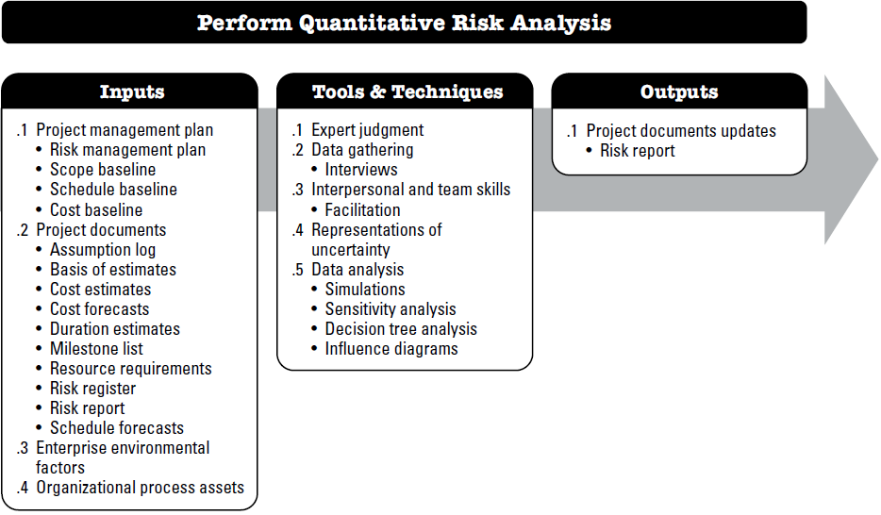
Perform quantitative risk analysis

Slide 30
Perform quantitative risk analysis
Input:
Project management plan
Risk management plan
Project documents
Assumption log, Basis of estimates, Cost estimates, Cost forecasts, Duration estimates, Milestone list, Resource requirements, Risk register, Risk report, Schedule forecasts
EEF - Industry studies of similar projects, and Published material, including commercial risk databases or checklists.
EEF & OPA
OPA - The organizational process assets that can influence Perform Qualitative Risk Analysis include but are not limited to information from similar completed projects.
cope baseline
Schedule baseline
Cost baseline

Slide 31
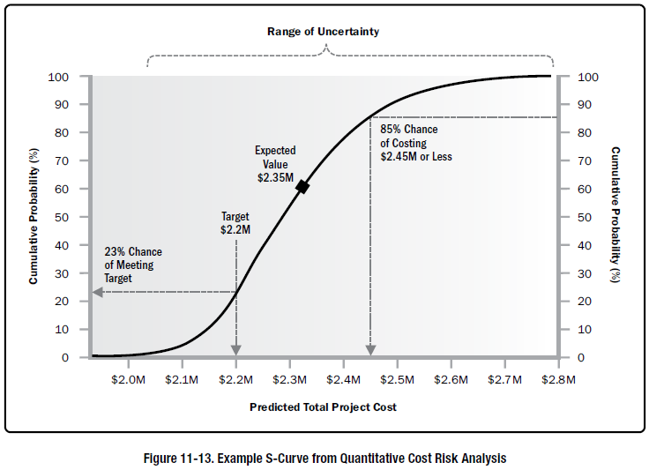
Perform quantitative risk analysis
Tools & Techniques:
Expert judgment
Data Gathering
Interpersonal and team skills
Representation of uncertainty – using probability distribution…
Data analysis – simulation, sensitivity analysis, decision tree analysis
Meetings

Slide 32
Perform quantitative risk analysis
As a project manager you need to decide whether to invest $120M to Build a new data center or to invest only $50M to upgrade the existing data center. If you decide to build a new one, then there is 60% chance that the new data center will help to generate revenue of $200M and 40% chance of generating revenue of $90M. Also, if you decide to upgrade the existing data center then there is 60% chance that it will help to generate revenue of $120M and 40% chance of generating revenue of $60M. Using proper data analysis method make your decision for the given scenario.

Slide 33
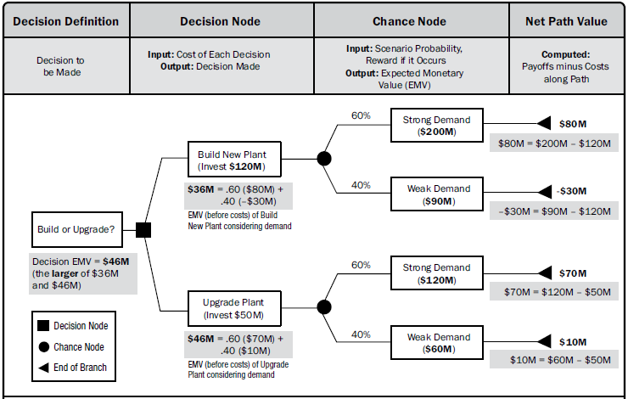
Perform quantitative risk analysis

Slide 34
Perform quantitative risk analysis
Output:
Assumption log.
Issue log.
Risk register.
Risk report.
Risk description | Probability | Cost impact | Expected Monetary Value (Probability x Impact) | Potential risk response
Networking hardware may fail during the project | .4 | - 50,000 | - 20000 | Taking action to purchase new HW within a short time.
Due to hardware failure data may be lost | .3 | - 20000 | - 6000 | Arrange some data backup process

Slide 35
Perform quantitative risk analysis
Your team has identified three risks with probabilities of 10%, 50%, and 35% during risk management planning. If the first two risks occur, they will cost you 5,000 USD and 8,000 USD; however, the third risk will give you 10,000 USD if it occurs.
Determine the expected monetary value of these risk events.
The expected monetary value (EMV) of three events = EMV of first event + EMV of second event + EMV of third event
= 0.10 * (–5,000) + 0.50 * (–8,000) + 0.35 * 10,000
= –1,000
Vendor A has a 50% probability of being on-time, a 30% probability of being late at an additional cost of $40,000 and a 20% probability of delivering early at a savings of $20,000. Vendor B has a 30% probability of being on-time, a 40% probability of being late at an additional cost of $40,000 and a 30% probability of delivering early at a savings of $20,000. Which vendor to chose ?

Slide 36
Plan Risk Response
The process of developing options and actions to enhance opportunities and to reduce threats to project objectives.
Process
Output
Plan risk Response
Change Request
PM plan updates
Project documents update

Slide 37
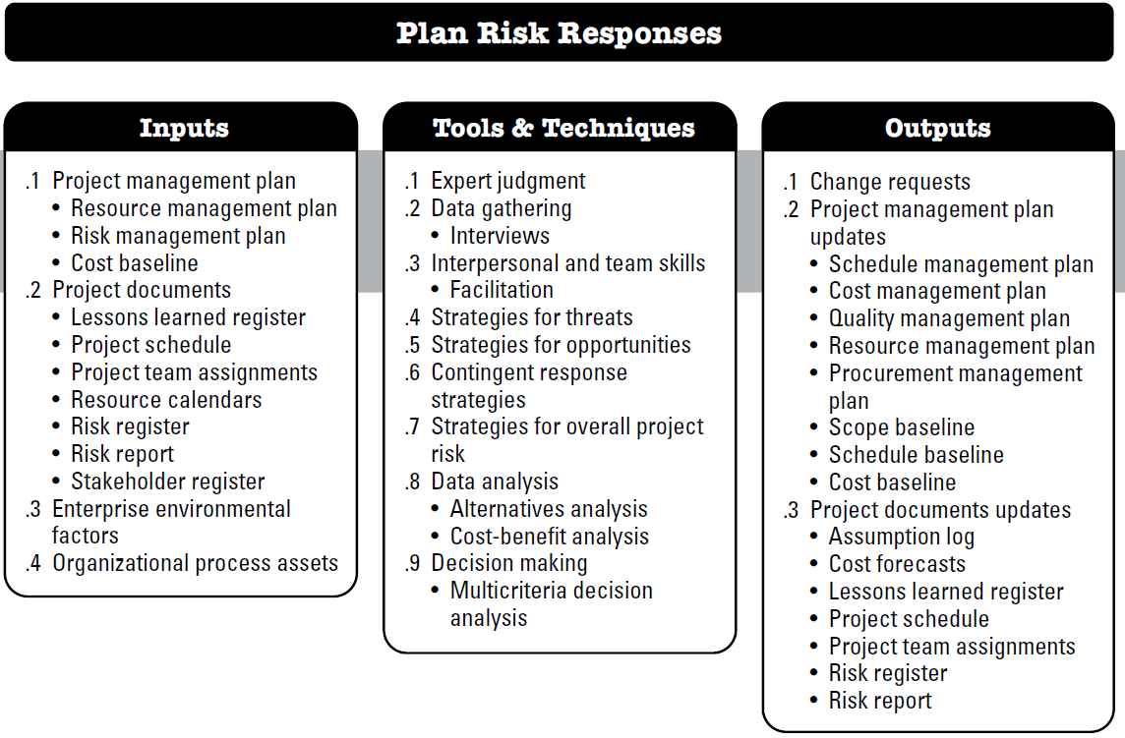
Plan risk Response

Slide 38
Plan risk Response
Input:
Project management plan
Risk management plan
Project documents
Lessons learned register, Project schedule, Project team assignments, Resource calendars, Risk register, Risk report, Stakeholder register
EEF - risk appetite and thresholds of key stakeholders.
EEF & OPA
OPA - Templates for the risk management plan, risk register, and risk report, Historical databases, Lessons learned repositories from similar projects.
Resource Management plan
Cost baseline

Slide 39
Plan risk Response
Tools & Techniques:
Expert judgment
Data Gathering
Interpersonal and team skills
Strategies for threats
Strategies for positive risks opportunities
Contingent response strategies
Strategies for overall project risk
Data analysis
Decision making

Slide 40
Plan risk Response
Tools & Techniques:
Transfer - One effective way
to deal with a risk is to pay someone else to accept it for you. The most
common way to
do this is to buy
insurance.
Risk: The company's server may fail, causing downtime. Response: Host the application on AWS or Azure with a Service Level Agreement (SLA).
Strategies for threats
  Avoid
  Mitigate
  Transfer
  accept
Mitigate - If you can’t avoid the risk, you can mitigate it. This means taking some sort of action that will cause it to do as little damage to your project as possible.
avoid it—if
you can prevent it
from happening,
it definitely won’t
hurt your project.
Accept- If you can’t avoid the risk, and there’s nothing you can do to reduce its
impact, then accepting it
is your only choice.
Risk: A new AI framework is unstable and may delay the project. Response: Decide not to use it
Risk: Developers may introduce bugs during deployment. Response: Implement automated testing, code reviews, and a staging environment
Risk: A minor UI bug may remain in the first release. Response: Document it in the risk register and fix it in the next update if it occurs.

Slide 41
Plan risk Response
Tools & Techniques:
Strategies for positive risks opportunities
Exploit: Ensure the opportunity definitely happens.
Enhance: Increase the probability or impact of the opportunity.
Share: Partner with another organization to maximize the opportunity.
Escalate: Pass the opportunity to someone better able to realize it.
Accept: Take no special action but benefit if it happens.

Slide 42
Plan risk Response
Tools & Techniques:
Strategies for positive risks opportunities
Opportunity: Your software company is developing an e-commerce website. During development, Google announces that your app has a chance to be featured on the Google Play Store, which could increase downloads by 500%.
Strategy | Response | Example
Exploit | Ensure the opportunity definitely happens. | Assign your best developers and testers to fix all remaining bugs, improve performance, and submit the app early so it fully meets Google's requirements.
Enhance | Increase the probability or impact of the opportunity. | Improve the app further by adding attractive features, optimizing the UI, and launching a marketing campaign. These actions make it more likely that Google will feature the app and increase the benefit if it does.
Share | Partner with another organization to maximize the opportunity. | Partner with a digital marketing agency. If the app gets featured, the agency immediately runs advertising campaigns so both your company and the agency benefit from the increased traffic.
Escalate | Pass the opportunity to someone better able to realize it. | Inform the CEO and senior management. They can negotiate directly with Google, allocate additional budget, or use their business contacts to maximize the chance of being featured.
Accept | Take no special action but benefit if it happens. | Submit the app as planned without spending extra money or effort. If Google features it, enjoy the increased downloads. If not, continue with the normal release plan.

Slide 43
Plan risk Response
Tools & Techniques:
Contingent response strategies
Some responses are designed for use only if certain events occur.
Events that trigger the contingency response, such as missing intermediate milestones or gaining higher priority with a seller, should be defined and tracked.
Risk responses identified using this technique are often called contingency plans or fallback plans and include identified triggering events that set the plans in effect.
Risk: The payment gateway integration may be delayed by the vendor.
Contingency Plan (Fallback Plan):
  Continue with the current vendor.
  If the vendor misses the agreed date by more than 2 weeks, switch to an alternative payment gateway.
Trigger Event:
  The payment gateway is not delivered by 15 September (or the intermediate milestone is missed).
What To do?
  Before 15 September: Do nothing.
  On 16 September: The trigger occurs, so the contingency plan is activated and the team starts integrating the backup payment gateway.

Slide 44
Plan risk Response
Output:
Project management plan Update
Management plans and baselines
Project documents Update
Risk register
Planned risk responses may result in a change request to the cost and schedule baselines or other components of the project management plan.
Change Request
Assumption log
Technical documents
Change requests

Slide 45
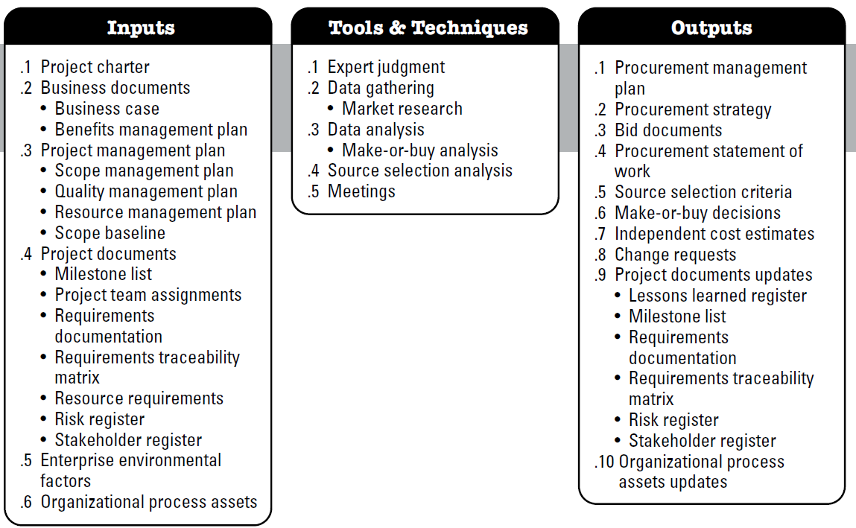
Plan Procurement Management
The process of documenting project purchasing decisions, specifying approaches and identify potential sellers.

Slide 46
Plan Procurement Management
Input:
Project charter
Business documents - Business case, Benefits management plan
Project management plan - Scope baseline, scope, quality and resource management plan
Project documents- Milestone list, Project team assignment, Requirements documentation, Requirements traceability matrix , Resource requirements, Risk register, Stakeholder register
EEF - Marketplace conditions; Products, services, and results that are available in the marketplace; Sellers, including their past performance or reputation;
OPA - Preapproved seller list, Contract type

Slide 47
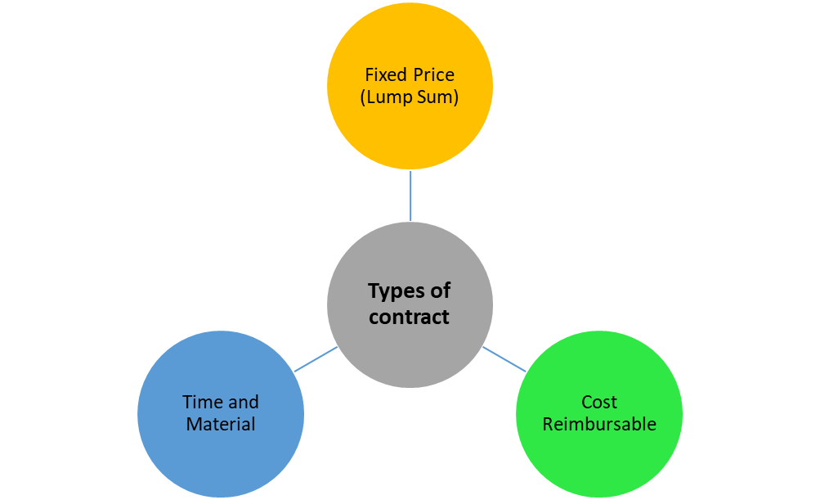
Plan Procurement Management
Input:
Contract type
Firm Fixed-Price contract (FFP)
Fixed-Price Incentive Fee contract (FPIF)
Fixed-Price with Economic Price Adjustment Contract (FP-EPA)
Cost-Plus Fixed Fee (CPFF)
Cost-Plus Incentive Fee (CPIF)
Cost-Plus Award Fee (CPAF)
Cost-Plus Percentage of Cost (CPPC)

Slide 48
Plan Procurement Management
Input:
Contract type
Fixed Price Contracts, a Fixed Amount of consideration is required to be paid by the Buyer to the Seller for the Specified Work.
Firm Fixed Price (FFP): The seller must complete the job or supply the product or service within an agreed amount of time and at a set price.
Fixed Price Incentive Fee (FPIF): Identical to a FFP contract except that the seller may receive an additional monetary incentive if they perform well – for example, completing the project ahead of schedule.
Fixed Price with Economic Price Adjustment (FP-EPA): Used in multi-year agreements to protect the seller from inflation – for example, costs will increase 3% after a certain amount of time.

Slide 49
Plan Procurement Management
Input:
Contract type
Cost Reimbursable Contracts, the Buyer is required to reimburse Actual Cost of Work and an Agreed Upon Fee to the Seller for the Specified Work.
Cost Plus Fixed Fees Contract (CPFF)
the seller is paid for all incurred costs plus a fixed fee, regardless of their performance. The buyer bears the risk. CPFF contracts keep the seller safe from risks.
Example: Total cost plus 25,000 USD as a fee.
Cost Plus Incentive Fees Contract (CPIF)
the seller will be reimbursed for all costs plus an incentive fee based upon achieving certain performance objectives mentioned in the contract. the risk lies with the buyer; however, it is lower than in the Cost-Plus Fixed Fee. In a CPIF contract, the incentive is a motivating factor for the seller. Generally, an incentive is a percentage of the savings that buyer and seller share.
Example: If the project is completed under budget, the seller will receive 25% of the savings.
An incentive fee is calculated based on a formula defined in the contract and is an objective evaluation. An award fee depends on the client’s satisfaction and is evaluated subjectively. An award fee is not subject to an appeal.

Slide 50
Plan Procurement Management
Input:
Contract type
Cost Plus Award Fee Contracts (CPAF)
the seller is paid for their costs plus an award fee. This extra will be based on achieving satisfaction according to specified performance objectives described in the contract.
Example: If the seller completes the task by meeting or exceeding quality standards based on their performance, the buyer may give an award of up to 10,000 USD.
Cost Plus Percentage of Cost (CPPC)
Here, the seller is paid for all costs incurred, plus a percentage of these costs. Buyers often do not prefer this type of contract because the seller might artificially increase the costs to earn a higher profit.
Example: Total cost plus 15% of the cost as a fee to the contractor.

Slide 51
Plan Procurement Management
Input:
Contract type
Time & Material Contracts, This is a hybrid of Fixed-Price and Cost-Reimbursable contracts. Here, both parties share the risk.
This contract is used to hire experts or outside support.
In this procurement contract, the buyer can specify the hourly rate with a “not-to-exceed” limit.
Example: You will pay a technician 20 USD per hour.

Slide 52
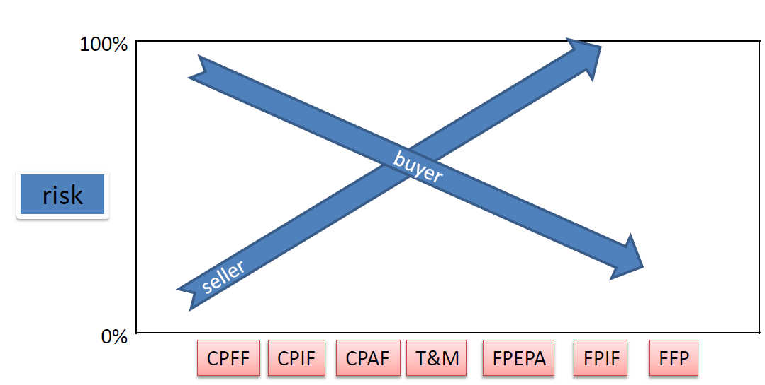
Plan Procurement Management
Input:
Contract type
Which “Type of Contract” is More Risky?
Who is taking the Project Risk – “Buyer” or the “Seller”?
A Risk that is high for the Buyer will be low for the Seller and vice versa
Fixed Price (FP) - Risk is low for the Buyer while it is high for the Seller.
Cost Plus (CP) - Risk is low for the Seller while it is high for the Buyer
Time & Material (T&M) - Both the Buyer and the Seller share the Risk.

Slide 53
Incentive calculation
Let us look at some terms
Target Cost – A pre-defined goal (cost objective) set by the buyer for the seller.
Actual Cost – Actual expenditure of the seller after completing the contracted work.
Target Fee – A pre-defined amount that is given to seller if contracted work is done at the Target Cost.
Target Price – A pre-defined sum of money that is given to seller if contracted work is done at Target Cost.
Ceiling Price – A pre-defined maximum sum of money that can be given to seller under any circumstance.
Cost Variance – The difference between Target Cost and Actual Cost. Positive variance is good for both the buyer and the seller.
Share Ratio – The ratio of dividing the Cost Variance between the buyer and the seller.

Slide 54
Incentive calculation
Formulas for Incentive Calculations
Price = Cost + Fee
Cost Variance = (Target Cost) – (Actual Cost)
Buyer’s Share = (Cost Variance) * (Buyer’s Share Ratio)
Seller’s Share = (Cost Variance) * (Seller’s Share Ratio)
Fee = (Target Fee) + (Seller’s Share)
Target Price = (Target Cost) + (Target Fee)

Slide 55
Incentive calculation
Let us assume that following data given to us.
Target Cost = 100K Target Fee = $20K
Ceiling Price = $130K Share Ratio = 50:50
We can conclude that
Target Price = $100K + $20K = $120K
Let us consider a scenarios and calculate the Price.
Actual Cost is less than the Target Cost Actual Cost = $90K
Cost Variance = $100K – $90K = $10K , The seller has saved $10K below the Target Cost.
Seller’s Share = 10*50% = $5K
Fee = $20K + $5K = $25K
Price = $90K + $25K = $115K
Price = Cost + Fee
Cost Variance = (Target Cost) – (Actual Cost)
Buyer’s Share = (Cost Variance) * (Buyer’s Share Ratio)
Seller’s Share = (Cost Variance) * (Seller’s Share Ratio)
Fee = (Target Fee) + (Seller’s Share)
Target Price = (Target Cost) + (Target Fee)
The buyer will pay $115K to the Seller which is less than Target Price ($120K). The seller will receive $25K as Fee, which is more than the Target Fee ($20K). Both the buyer and the seller get the benefit of cost saving.

Slide 56
Incentive calculation
Let us assume that following data given to us.
Target Cost = 100K Target Fee = $20K
Ceiling Price = $130K Share Ratio = 50:50
We can conclude that
Target Price = $100K + $20K = $120K
Let us consider another scenarios and calculate the Price.
Actual Cost is grater than the Target Cost Actual Cost = $110K
Cost Variance = $100K – $110K = -$10K , seller has spent $10K more than the Target Cost. Seller’s Share = -10*50% = -$5K
Fee = $20K - $5K = $15K
Price = $110K + $15K = $125K
Price = Cost + Fee
Cost Variance = (Target Cost) – (Actual Cost)
Buyer’s Share = (Cost Variance) * (Buyer’s Share Ratio)
Seller’s Share = (Cost Variance) * (Seller’s Share Ratio)
Fee = (Target Fee) + (Seller’s Share)
Target Price = (Target Cost) + (Target Fee)
The buyer will pay $125K to the Seller which is more than the Target Price ($120K). The seller will receive $15K as Fee, which is less than the Target Fee ($20K). Both the buyer and the seller are at a disadvantage.

Slide 57
Point of total Assumption(PTA)
The Point of Total Assumption marks the threshold beyond which the seller becomes responsible for covering the costs of the contracted work.
Let us use the previous example to understand PTA
Target Cost = 100K Target Fee = $20K
Ceiling Price = $130K Share Ratio = 50:50 (buyer : seller)
Target Price = $100K + $20K = $120K
Let us look at a particular scenario when Actual Cost=$120K. Let us calculate the Actual Price.
Cost Variance = $100K – $120K = -$20K, seller has spent $20K more than the Target Cost.
Seller’s Share = (-20)*50% = -$10K
Fee = $20K – $10K = $10K
Price = $120K + $10K = $130K
The buyer will pay $130K to the Seller, which is also the Ceiling Price. The price is capped at $130K. So, if the seller spends anything more than $120K, the extra cost will have to be borne by the seller. For our example, PTA is $120K.

Slide 58
Point of total Assumption(PTA)
From the example, we already know two things. At PTA
  AC will be equal to PTA
  the buyer will pay CP to the seller
We already know that
price = cost + fee
So for PTA it will be CP = PTA + Fee
CP = PTA + [TF + (TC – AC) *SR]
In our case, AC is PTA. Replacing AC with PTA we get
CP = PTA + [TF + (TC – PTA)*SR]
CP = PTA + [TF + (TC – PTA)*(1-BR)]
CP = PTA + TF + TC – TC*BR – PTA + PTA*BR
CP = (PTA*BR – TC*BR) + (TF + TC)
CP = (PTA – TC)*BR + TP
PTA = ((Ceiling Price – Target Price)/Buyer’s Share Ratio )+ Target Cost
Above the PTA, the seller pays 100% of the additional costs

Slide 59
Quiz Time
A cost-plus-incentive-fee contract has the following characteristics:
Sharing ratio: 80/20
Target cost: $100,000
Target fee: $12,000
Ceiling Price : $120000
How much will the seller be reimbursed if the cost of performing the work is $95,000?
Calculate the PTA
Fee = (( 100,000–95,000) * 20% ) + 12,000=5,000 * 20% + 12,000=1,000 + 12,000=13,000
Price = 95000 + 13000 = 108,000
PTA = ((Ceiling Price – Target Price)/Buyer’s Share Ratio )+ Target Cost
= ((120000 – 112000)/80% ) + 100000
= 110000

Slide 60
Plan Procurement Management
Tools & Techniques:
Expert judgment
Data Gathering
Data Analysis - Make-or-buy analysis
Source Selection Analysis
Meetings

Slide 61
Plan Procurement Management
Output:
Procurement Management Plan
    Provides guidance for -
    •Types of contract
    •risk management issues
    •Independent estimates to be used
    •Standard procurement document
    •Managing multiple supplier
    •Coordinating procurement with other project aspects
    •Format of SOW
    •WBS for contractor
    •Metric to evaluate seller

Slide 62
Plan Procurement Management
Output:
Procurement strategy
Bid documents - RFI, RFB, RFP, RFQ, tender notice, invitation for negotiation
Procurement statement of work
Source selection criteria- Criteria for scoring seller proposal. Understanding of needs, overall or life cycle cost, technical capacity, risk, management approach, technical approach, warranty, financial capacity
Make or buy decision - Documents regarding the conclusion reached
Independent cost estimates
Change request
Project doc update - Requirement documents, requirement tractability matrix , risk register
OPA update

Slide 63
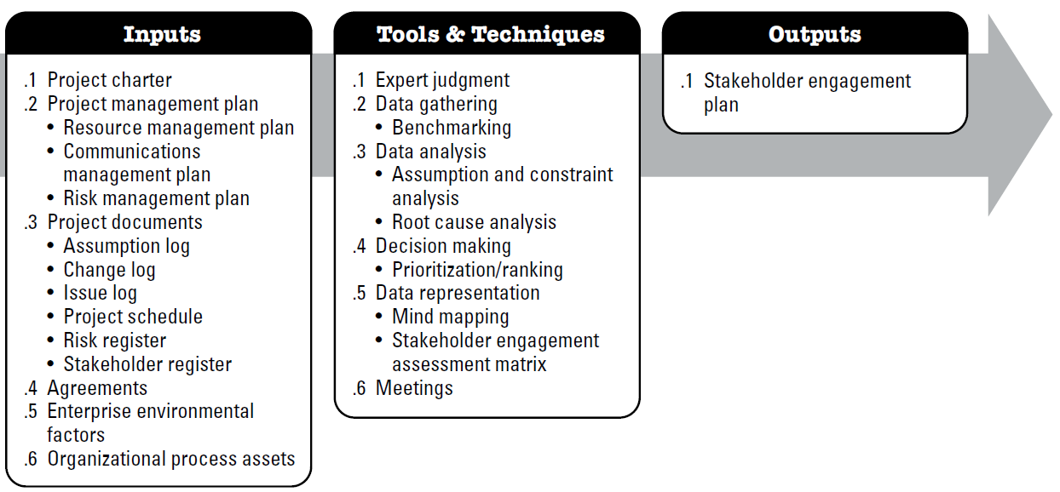
Plan stakeholder Engagement
The process of developing appropriate management strategies to effectively engage stakeholders throughout the project lifecycle.

Slide 64
Plan stakeholder Engagement
Input:
Project management plan
Resource management plan, Communications management plan, Risk management plan
Project documents
Assumption log , Issue log, project schedule, change log, stakeholder register, risk register
Agreements
involves working with the procurement/contracting group in the organization to ensure contractors and suppliers are effectively managed.
contains information on the project purpose, objectives, and success criteria that can be taken into consideration when planning how to engage stakeholders.
Project Charter
EEF - Organizational culture, political climate, and governance framework, Personnel administration policies, Stakeholder risk appetites, Established communication channels
EEF

Slide 65
Plan stakeholder Engagement
Input:
Corporate policies and procedures for social media, ethics, and security;
OPA
Corporate policies and procedures for issue, risk, change, and data management;
Organizational communication requirements;
Lessons learned repository with information about the preferences, actions, and involvement of stakeholders; and
Software tools needed to support effective stakeholder engagement.
Standardized guidelines for development, exchange, storage, and retrieval of information;

Slide 66
Plan stakeholder Engagement
Tools & Techniques:
Expert judgment
Data Gathering
Data Analysis
Decision Making
Data Representation - Mind mapping, Stakeholder engagement assessment matrix
Meetings
The engagement level of stakeholders can be classified as follows:
Unaware. Unaware of the project and potential impacts.
Resistant. Aware of the project and potential impacts but resistant to any changes that may occur as a result of the work or outcomes of the project. These stakeholders will be unsupportive of the work or outcomes of the project.
Neutral. Aware of the project, but neither supportive nor unsupportive.
Supportive. Aware of the project and potential impacts and supportive of the work and its outcomes.
Leading. Aware of the project and potential impacts and actively engaged in ensuring that the project is a success

Slide 67
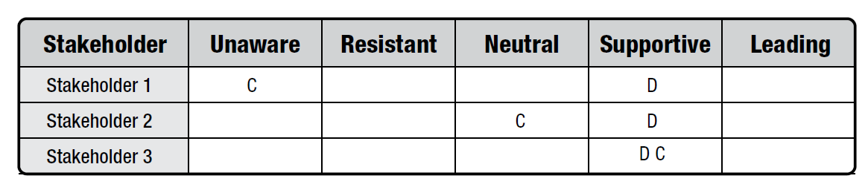
Plan stakeholder Engagement
Tools & Techniques:
Stakeholder engagement assessment matrix
C represents the current engagement level of each stakeholder
D indicates the level that the project team has assessed as essential to ensure project success (desired).
The gap between current and desired for each stakeholder will direct the level of communications necessary to engage the stakeholder effectively.

Slide 68
Plan stakeholder Engagement
Output:
Stakeholder Engagement plan
identifies the strategies and actions required to promote productive involvement of stakeholders in decision making and execution. It can be formal or informal and highly detailed or broadly framed, based on the needs of the project and the expectations of stakeholders.
Project schedule, Stakeholder register
PROJECT DOCUMENTS UPDATES

Slide 69
Develop Project Management Plan
The process of defining how the project will be executed, monitored, controlled and closed
Process
Output
Develop Project Management Plan
Project management plan

Slide 70
Develop Project Management Plan
What does it(PM Plan) contain
Project management processes selected by team
The description of tools and techniques to be used
How the selected processes will be used to manage the project
How work will be executed
How changes will be monitored and controlled
All subsidiary plans from other process group
How configuration Management will be performed

Slide 71
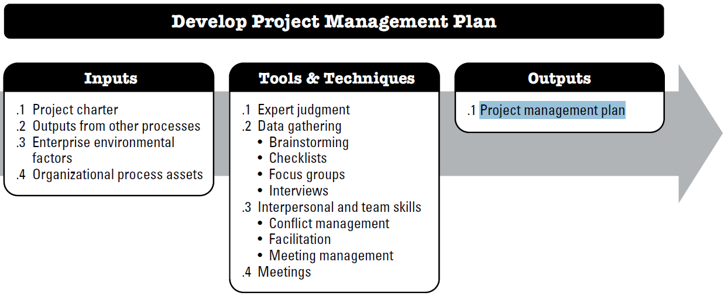
Develop Project Management Plan

Slide 72
Develop Project Management Plan
Input:
Project Charter
Project managers get high level guideline from the charter
Output from other processes
Output already discussed for other planning processes are integrated to project management plan
EEF
Govt or industry standard
OPA
Standard guidelines, work instruction, proposal evalution criteria and performance measurement criteria
Includes baseline and subsidiary management plan
PMIS
Organizational Culture
Personnel Administration
Infrastructure
PM template
Change control procedure
Project file from past projects

Slide 73
Develop Project Management Plan
Tools & Techniques:
Expert judgment
Data Gathering
Interpersonal and team skills
Meetings

Slide 74
Develop Project Management Plan
Output:
Project Management Plan
How work will be implemented
Change and configuration management plan
How the performance will be measured
Baselines
  –Scope
  –Schedule
  –Cost
Subsidiary Plans
  –Scope, Requirement, schedule, cost, Quality, process improvement, HR, Communication, risk and procurement management plan.

Slide 75
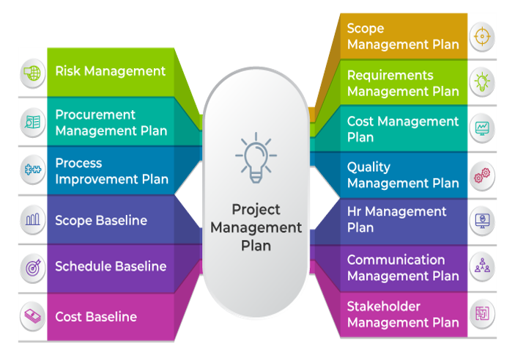

Slide 76
Project Management Plan (The PM Plan)
Defines how the project will be executed, monitored, controlled and closed.
  Defines, integrates and coordinates all other plans and baselines
  It’s content will vary depending on the application area and project complexity
  Progressively elaborated

Slide 77
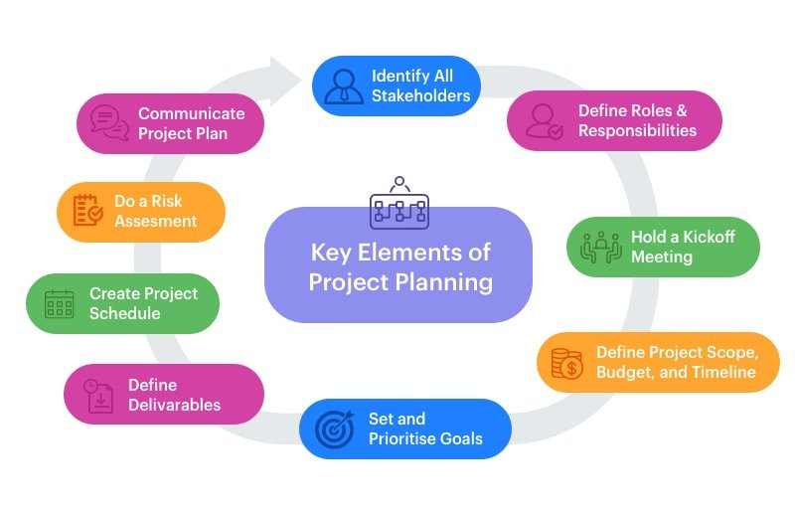
Project Management Plan (How to prepare)

Slide 78
End of Planning Process Group

